Slide 1
Living Well through the Coronavirus Pandemic
Tools and Strategies for Coping Effectively
Suzanne Burger, PsyD

Slide 2
+545 × 413

Slide 4
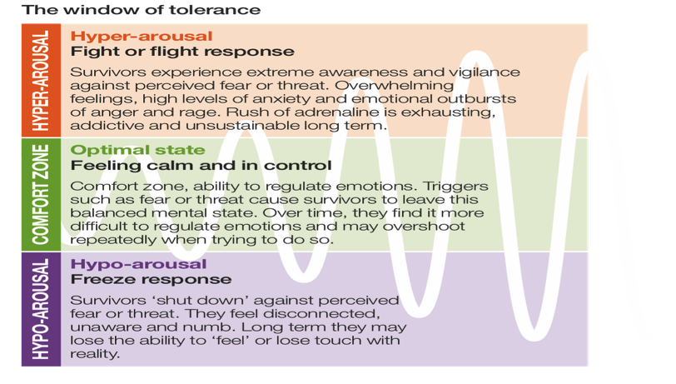

Slide 5
Reactions/Emotions
Anxiety
Fear
Sadness ranging to Depression
Anger
Helplessness
Shame
Denial/Minimization
Activation of preexisting OCD or PTSD symptoms
Distinction between primary and secondary emotions

Slide 6
We are rarely in imminent, life or death danger!

Slide 7
We cannot change the cards we are dealt, just how we play the hand
You do have influence over how you respond to what is happening

Slide 9
General Recommendations
Maintain structure/routine
Maintain healthy diet
Maintain good sleep habits
Maintain or increase fitness regimen
Get creative about social engagement: e.g. plan a Zoom gathering of friends
Touch when possible or self-touch otherwise
Reduce exposure to news/social media
Reframe containment as opportunity for “some day” or bucket list opportunities
Self-empowerment through gratitude practice and/or playing it forward

Slide 10
Down-regulating Activities/Resources
Sensory Awareness (5-4-3-2-1) and
Grounding
Yoga
Breathwork (in for 4/hold for 4/out for 6-8)
Imagery/Visualization (work of Belleruth Naparstek)
Aerobic exercise (discharge excess energy)
Massage/Touch
Sex
Self-touch for support/containment

Slide 11
Down-Regulating Activities/Resources
Nature/Walks/Hikes
Soothing Music
Reading poetry/fiction/biographies/etc…
Pets
Hobbies (needlework, gardening, etc…)
Developing patience and compassion towards one’s own emotions
Meditation, Prayer, Reiki
Social Engagement
Humor

Slide 12
Up-Regulating Activities/Resources
Dance
Movement/Exercise
Up-tempo Music
Singing
Laughter
Social-engagement
Prosocial activity (volunteering, possibly remotely)
For IW, ongoing activism/letter-writing/postcards/preparations for fall campaign
Opportunities for creativity

